Slide 1
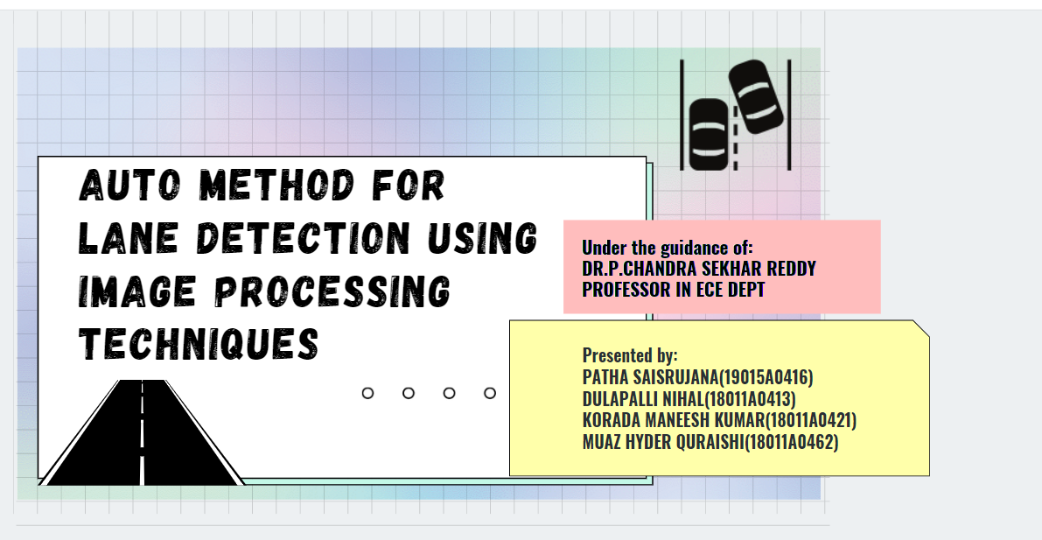

Slide 2

INTRODUCTION
FUNCTIONAL PRINCIPLE
ADVANTAGES
DISADVANTAGES
APPLICATIONS
FUTURE SCOPE
CONCLUSION
REFERENCES
CONTENTS

Slide 3
Lane recognition on freeways is an essential part of any successful autonomous driving system.
An autonomous car consists of an extensive sensor system and several control modules.
The most critical step to robust autonomous driving is to recognize and understand your surroundings.
However, it is not enough to identify obstacles and understand the geometry around a vehicle.
Camera-based Lane detection enables the car to be correctly positioned within the lane, which is crucial for every exit and the back lane - planning decision.
Camera-based accurate lane detection with real-time edge detection is vital for autonomous driving and avoiding traffic accidents.
INTRODUCTION

Slide 4
MATLAB serves as an image processing tool for the detection of lanes on the road. The following techniques are used for lane detection.
• Color Mask
• Canny Edge Detection
• Region of Interest Selection
• Hough Transform Line Detection
FUNCTIONAL PRINCIPLE

Slide 5
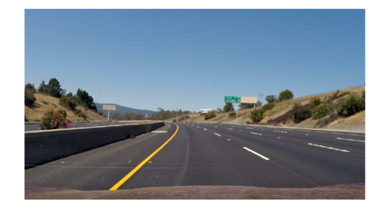

Pre-processing the Image
The aim of pre-processing is to improve the quality of image so that we can analyze it in a better way.
Using pre-processing we can suppress undesired distortions and enhance some features which are necessary for particular application working.
Here we are extracting each frame from given input video and subjecting it to 3-D Gaussian filtering which is used to smoothen the edges of an image to reduce noise.
Original Image
Filtered Image

Slide 6
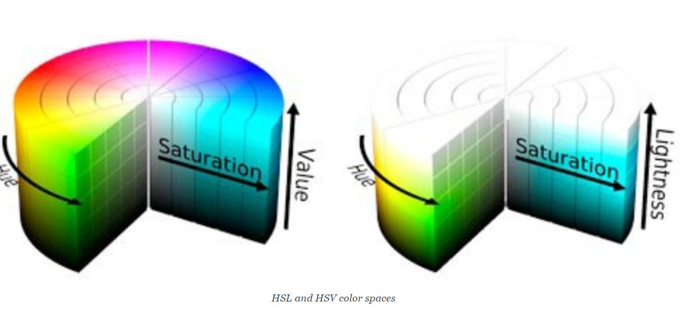
Convert To Different Color Spaces
HSV model is a cylindrical coordinate representation of points in a RGB color model.
HSV is often referred to as HSB (Hue Saturation and Brightness) but HSL is slightly different where L stands for Lightness, is not the same as Brightness/Value.
HSL is better at contrasting lane lines than HSV. HSV blurs white lines too much, so it would not be suitable for us to opt for it in this case. It will be easier for us to isolate yellow and white lanes using HSL.

Slide 7
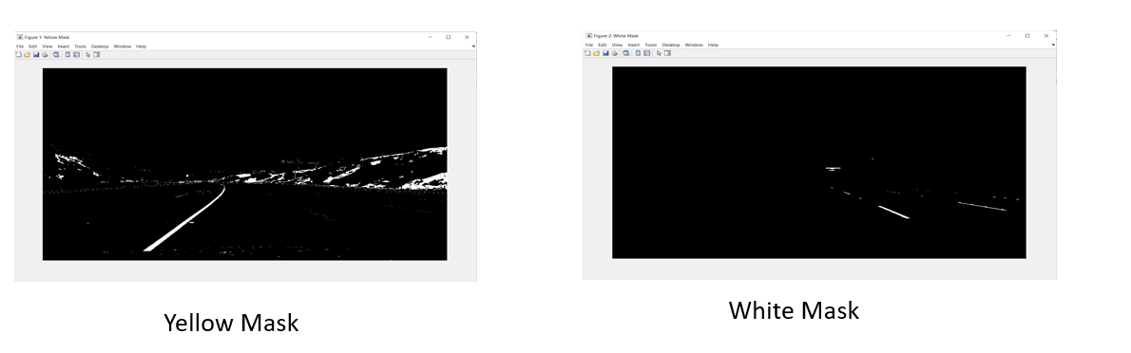
Isolating Yellow And White From HSL Image
We first isolate yellow and white from the original image and convert them to gray scale.
since the road is black, anything that is much brighter on the road will come out with a high contrast in a grayscale image.
The conversion from HSL to grayscale helps in reducing noise even further. This is also a necessary pre-processing step before we can run more powerful algorithms to isolate lines.

Slide 8
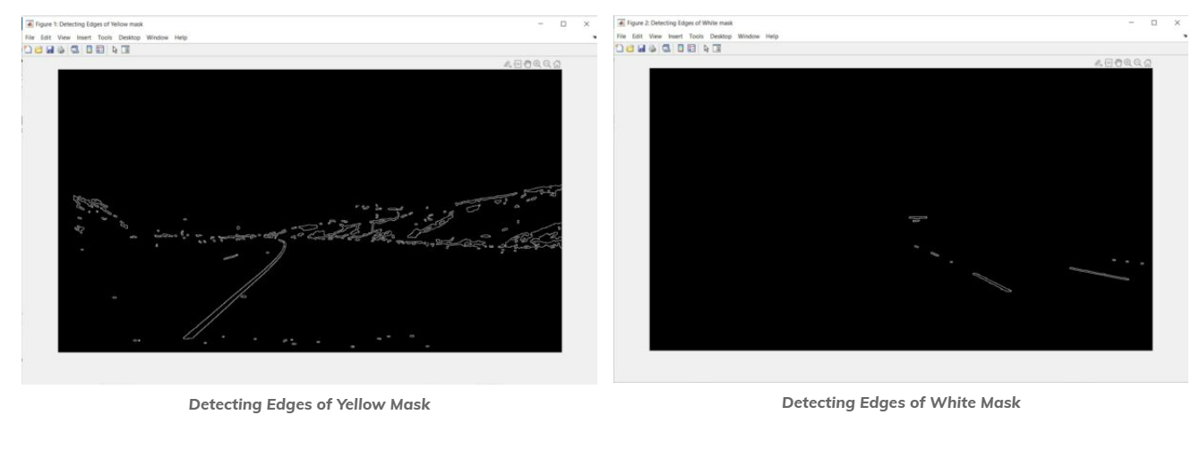
Edge Detection
Now that we have sufficiently pre-processed the image, we can apply a Canny Edge Detector, whose role it is to identify edges in an image and discard all other data.
The resulting image ends up being wiry, which enables us to focus on lane detection even more, since we are concerned with lines.
Any point beyond the high threshold will be included in our resulting image, while points between the threshold values will only be included if they are next to edges beyond our high threshold. Edges that are below our low threshold are discarded.

Slide 9
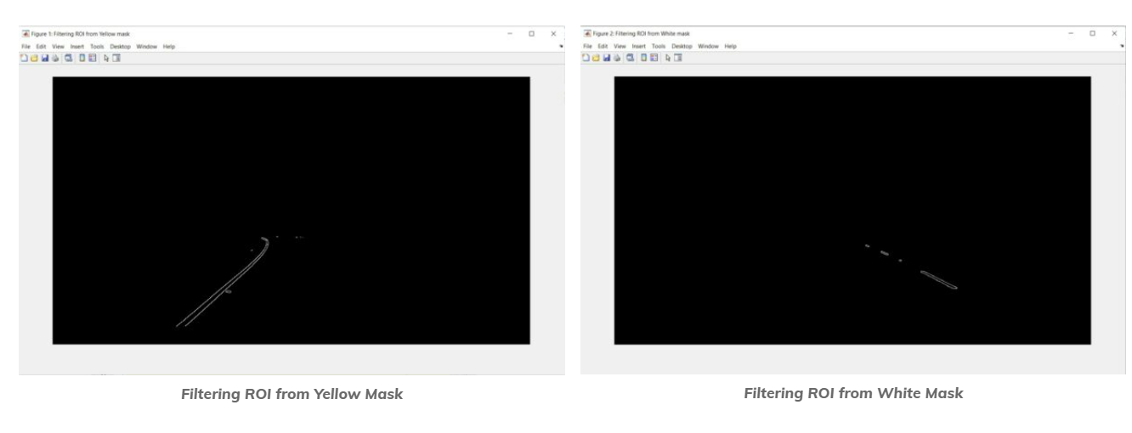
Our next step is to determine a region of interest and discard any lines outside of this polygon.
One crucial assumption in this task is that the camera remains in the same place across all these image, and lanes are flat, therefore we can identify the critical region we are interested in.
We can display an ROI as a binary mask image: In the mask image, the pixels belonging to the ROI are set to 1, and the pixels outside the ROI are set to 0.
Extracting Region Of Interest (ROI)

Slide 10
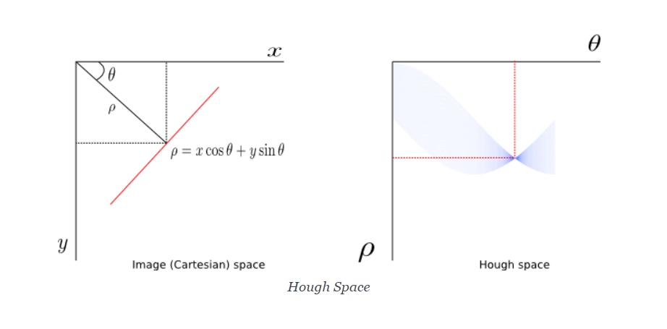
Hough Transform
Hough Transform technique to extract lines and color them.
The goal of Hough Transform is to find lines by identifying all points that lie on them.
This is done by converting our current system denoted by axis (x, y) to a parametric one where axes are (m, b).
In polar coordinates, a given line can be expressed as (ρ, θ) ; that is ρ = xcosθ + ysinθ. All straight lines going through a given point will correspond to a sinusoidal curve in the (ρ, θ) plane.
This naturally means that the problem of detecting points on a line in cartesian space is reduced to finding intersecting sinusoids in Hough space.

Slide 11
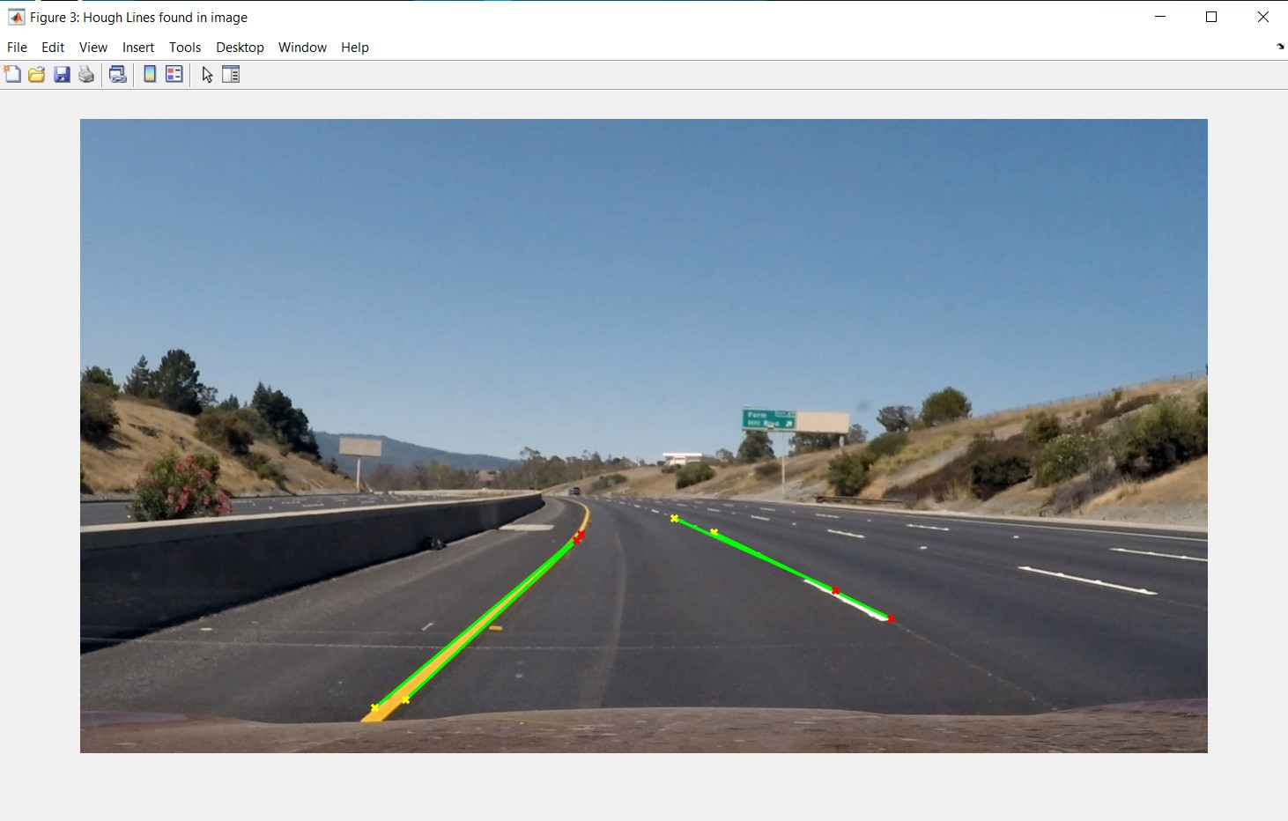
Each pixel on an edge is mapped to lines which are represented thetas and rhos. If the distance is less than maxLineGap , then it is assumed that edge lies on that line. The lines has edge pixels greater than minLineGap are finally identified and saved.
The Hough transform returns lines, and the below images show what they look like.
Hough lines found in image

Slide 12
These systems will quickly alert the driver if their vehicle should cross over the dividing lanes, thereby helping them to avoid an accident.
This concept is used to describe the path for self-driving cars and to avoid the risk of getting into another lane.
High performance and efficient system.
Realizes the intelligence and automate the modern transportation system.
ADVANTAGES

Slide 13
The road lane detection tends to be only robust under specific road types and condition.
During night time, part of lanes are overexposed and sometimes fails to detect the road markings.
There may be a faulty detection in curvy roads.
DISADVANTAGES

Slide 14
Autonomous or driverless cars.
Lane departure warning systems(LDWS) which play a key role in the prevention from accidents.
Headway monitoring and warning.
Computer vision and machine learning applications.
APPLICATIONS

Slide 15
FUTURE SCOPE
In this project, we have used image processing techniques to detect lane boundary lines. The proposed method has offered good performances, but it has to be improved in order to be adapted with bad weather conditions (e.g. rain and snow) and bad light conditions (night time).
This model can be updated and turned with more efficient mathematical modelling.
It can be recoded with OPEN CV.
Can be used in increasing number of applications such as traffic control, traffic monitoring, traffic flow, security etc.

Slide 16
CONCLUSION
The project was successful in that the video images clearly show the lane lines are detected properly and lines are very smoothly handled.
It only detects the straight lane lines.
It is an advanced topic to handle curved lanes (or the curvature of lanes).
We'll need to use perspective transformation and also poly fitting lane lines rather than fitting to straight lines.

Slide 17
REFERENCES
Ajit Danti, Jyoti .Y. Kulkarni, P.S.Hiremath, A RealtimeRoad Boundary Detection and Vehicle Detection forIndian Roads, International Journal of AppliedInformation Systems, ISSN : 2249-0868, Volume 5– No.4, March 2013
Gurjyot Kaur , Amit Chhabra ,Curved Lane Detectionusing Improved Hough Transform and CLAHE in aMulti-Channel ROI, International Journal of ComputerApplications , Volume 122 – No.13, July 2015
Computer Vision: Lane Finding Through Image Processing | by Archit Rastogi | The Startup | Medium
Lane Detection Using Image Processing for Driving Assistance | SpringerLink
Lane Detection - MATLAB & Simulink - MathWorks India
Using Computer Vision to Find Lane Lines on Road · (edforson.me)

Slide 18
THANK YOU !

